Slide 1







Oncology/Haematology
Telephone Triage Tool Kit
for Paediatric Cancer Services
This presentation supports both initial and refresher training
2nd Edition 2020
Review date:
August 2023

Slide 2
This presentation will cover….
What is the Telephone Triage Tool Kit?
  Background
  Training and competency achievement
  Evaluation
  Implementation
How to use the Tool Kit
Notes:
Background
United Kingdom Oncology Nursing Society (UKONS)
Adult version developed in 2007/2009 Positively evaluated. Original release 2010, 2nd Edition Nov 2016
Now used widely in all areas of the UK and internationally
No serious incidents or adverse events due to the use of tool kit reported during the pilot or since release
All cases which were discussed by a Coroner were in relation to misuse of the Tool or Trusts locally adapting without rationale or permission

Slide 3
Aim of the Tool Kit
To provide guidance and support to the practitioner
at all three stages of the triage process:
Contact and data collection / record of reported symptoms
Assessment/definition of problem
Appropriate intervention/action.
The Tool Kit has been developed to provide:
A simple, reliable assessment process
Safe, understandable advice
Communication and record keeping
Competency based training
An audit tool.

Slide 4
The Paediatric Toolkit
Evaluation has shown the Tool to be reliable, robust and valuable.
The Toolkit is a standardised approach to triage and assessment, providing:
  An evidence-based assessment tool
  A log sheet checklist; to prompt practitioners, record triage of symptoms, assessment and communication with families.
It sets a standard for best practice and is an excellent training and educational resource:
  It can be used to provide evidence of quality and safety for both the organisation and the individual practitioner
  It is useful in identifying risks and poor practice, helping to determine education and training needs
  It can support consistency of advice, and consistency of service across POSCUs and PTCs as well as between centres.
It is endorsed by Royal College of Nursing (RCN), Children's Cancer and Leukaemia Group (CCLG), UK Oncology Nursing Society (UKONS) and CLIC Sargent

Slide 5
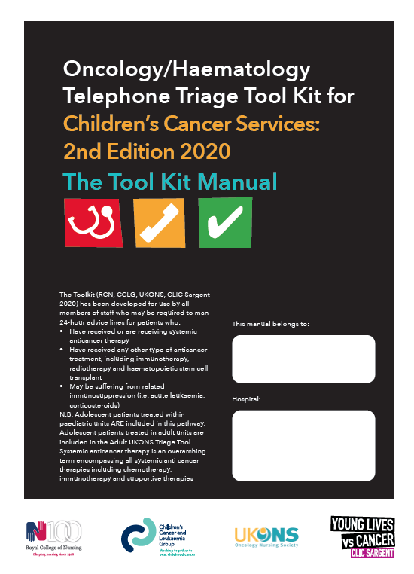
Training
All staff must have read the 24 hour triage training manual
All staff using the Tool Kit must receive training and assessment of competency.
Staff who are not trained to use the Tool Kit should not provide telephone advice.

Slide 6
What is The Telephone
Triage Tool Kit?
A risk assessment tool using a RAG
(RED, AMBER, GREEN) scoring system.
For telephone triage of children and
young people with cancer and serious
blood disorders.

Slide 7
Scoring system
Action / Symptom selection is based on the triage practitioner’s grading of the presenting symptoms/toxicity following interview, data collection and triage:
RED – any toxicity graded here takes priority and action must follow immediately. Caller advised that patient must attend for urgent assessment as soon as possible. You should consider halting the remaining assessment if emergency care is needed.
2 or more AMBER = RED – if a patient has two or more toxicities graded amber they must be escalated to red action and caller advised that patient must attend for urgent review as soon as possible
AMBER – one toxicity in the amber area must be followed up with a telephone call from an identified member of staff within 24 hours. The caller must be instructed to call back if the patient’s condition deteriorates, their symptoms worsen or they continue to have concerns
GREEN – The caller must be instructed to call back if the patient’s condition deteriorates, their symptoms worsen or they continue to have concerns.

Slide 8
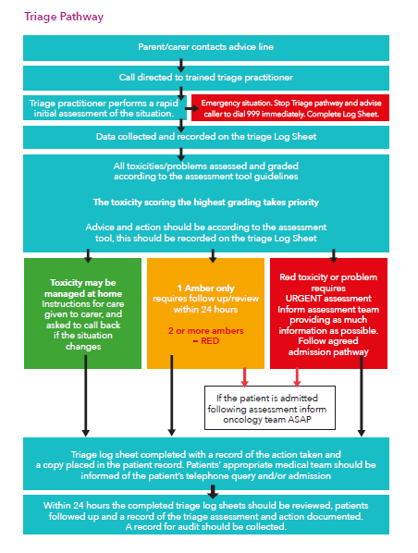

Slide 9
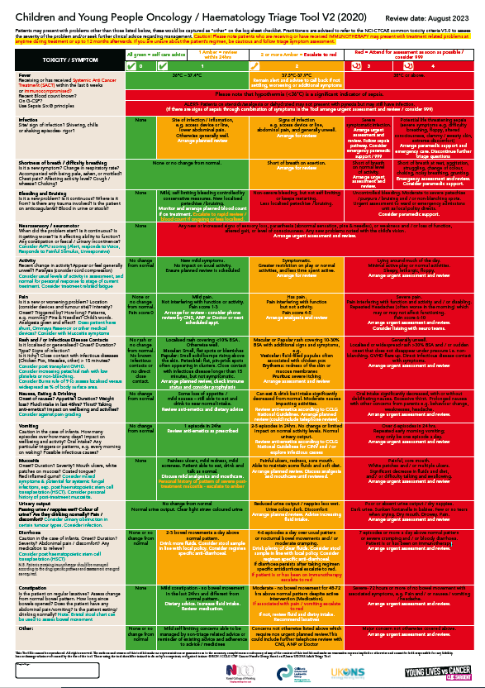
The assessment tool will:
Determine “the patient’s level
of risk”
Prompt the practitioner with appropriate questions to ask, to gain information from the patient
Provide a reliable guide to toxicity/problem grading
Prioritise the level of urgency indicated by the presenting symptoms and will aid in identifying potential emergency situations.

Slide 10
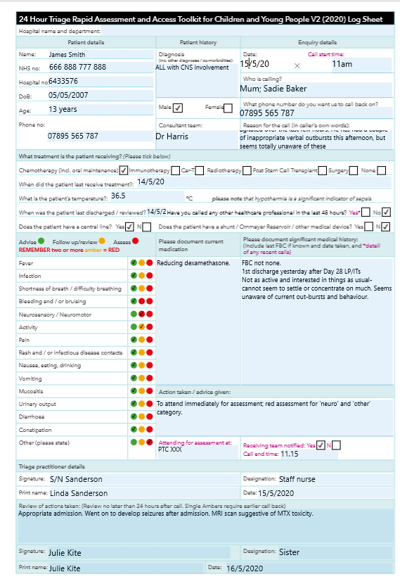

Contact record – the ‘Log Sheet’
It is vitally important that the data collection process is methodical and thorough in order for it to be useful and provide an accurate record of the triage assessment.
A Log Sheet should be completed for all calls and unscheduled patient visits. This will facilitate audit of the helpline service.
The Triage boxes MUST all be marked accordingly.
IF YOU HAVEN’T TICKED IT,
YOU HAVEN’T ASKED IT!

Slide 11
Step 1- Data collection
Perform a rapid initial assessment of the situation: “Is this an emergency?” Do you need to stop and contact the emergency services instead .......999
Does the caller understand, communicate with you? If not take name, contact details and other data at the top of log sheet and advise caller to attend for urgent review as soon as possible or proceed to step 2
Ask questions in a logical sequence. Follow the log sheet and the assessment tool
Provide information slowly and thoughtfully assess the callers comprehension, anxiety and distress throughout the process
Do you have any doubt about the patient / carer’s ability to provide information accurately or understand questions or instructions provided? If so then a face-to-face consultation must be arranged
Record caller’s name and current contact details in case the call is
interrupted and you need to get back to the caller.

Slide 12
Step 2 – Assessment of child/YP
What is the patient / carer’s initial concern, why are
they calling?
You should assess and grade this problem first, ensuring that you record this on the Log Sheet. If this score is RED then you may decide to stop at this point and proceed to organising urgent face-to-face assessment
If the patient is stable you may decide to complete the assessment process in order to gather further information for the face-to-face assessment.

Slide 13
Step 3 – RAG grading assessment
If the patient / carer’s initial concern scores AMBER, record this on the Log Sheet and proceed with further assessment
Move methodically down the triage assessment tool, asking appropriate questions. e.g. Do you have any nausea? If NO tick the green box on the Log Sheet and move on
If YES use the questions provided to help you grade the problem and note either amber or red and initiate action (tick the Log Sheet)
The 2020 version includes asking about shunts or Ommaya reservoirs as well as other medical devices. This might influence your grading.
If the patients symptoms score RED or another AMBER at any time they should be asked to attend for assessment

Slide 14
Step 4 – checking the record
Look back at your Log Sheet
Have you arranged assessment for patients who have scored RED?
Have you arranged assessment for patients who have scored more than one AMBER?
Have you fully assessed all the patients who have scored one AMBER,
is there a tick in all the other green boxes of the Log Sheet?
Have you fully assessed all the patients who have scored GREEN,
is there a tick in all the other green boxes of the Log Sheet?
Have you recorded the action taken and advice given?
Have you documented any decision you have taken or advice you have given that falls outside this guideline, and recorded the rationale for
your actions?
Have you fully completed the triage process?

Slide 15
Special considerations
If, in the triage practitioner’s clinical judgement, the guideline is not appropriate to that individual situation, the rationale for that decision should be clearly documented
If the triage practitioner’s assessment is borderline select the higher risk category;
be cautious
The organisation must agree the triage pathway and populate it with local detail
and responsibilities. Refer to training manual for guidance on Trust Governance

Slide 16
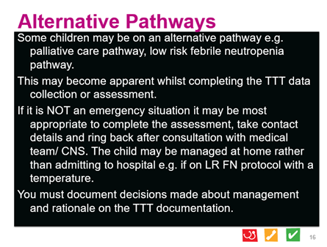

Slide 17
Log Sheet review
The Hospital Designated Responsible Practitioner must review
all Log Sheets within 24 hours of the call as follows:
Original log sheet “Review of actions taken” should be completed and filed in the patients medical records
GREEN | Was this the correct advice? If not is any action / training needed now?
1 AMBER | Call the patient to assess if they are improving or not?
2 AMBER or RED | Follow the patient: were they admitted or not?
Admitted or Discharged | Admitted - find them and check management. Discharged - call to see if they are improving.

Slide 18
Scenarios and reflective learning

Slide 19
Scenarios, role play and reflection
A number of training scenarios are available as an addition to this training pack.
Your local trainer may have alternative local scenario’s or they may choose to constructively critique and reflect on some real log sheets from your centre.

Slide 20

Guide to using scenarios
Use a selection of the provided scenarios or use one from the local team or group experiences;
Role play giving information or taking the call and recording
Support general discussion about the value and relevance of the triage process
Demonstrate practical application of the triage process in the clinical setting.
Document your assessment on a Log Sheet
Discuss your thinking and rationale for decisions with your group

Slide 21
Guide to using review and reflective constructive critique
Randomly select Log Sheets from your centre. Facilitators should anonymise staff who completed the log;
Discuss what you think has been done well
Discuss what you think could be improved
Did you disagree with any information – why?
Discuss your thinking and rationale for your critique with your group

Slide 22
This toolkit is being adopted as the national standard. Today we learned that;
It can improve patient safety and care by ensuring that everyone receives a robust, reliable assessment every time they contact the paediatric oncology helpline for advice.
It ensures assessments are of a consistent quality and uses an evidence-based assessment tool
It provides management and advice appropriate to the patient’s level of risk.
It ensures that those patients who require urgent assessment in hospital are identified and that appropriate action is taken.
It can also identify and reassure those patients who are at lower risk and may safely be managed by parents / carers or the primary care team or through a planned clinical review and avoid unnecessary emergency attendance
It provides triage training and competency assessment for practitioners
It facilitates accurate records of the assessment and decision-making process in order to monitor quality, safety and activity.
Families have more confidence in care when they experience consistent approaches.

Slide 23
Any questions?
?

Slide 24

Thank you!
This training pack was developed by the RCN / CCLG Children and Young People’s Telephone Triage Tool Kit Working Group (2020), with design and support from CLIC Sargent. www.rcn.org.uk/
CLIC Sargent is pleased to support this work for the benefit
of children and young people with cancer and their families,
and is also supporting training.
The CCLG supports dissemination of the documents through hosting them for open access on their website. www.cclg.or.uk
To find out more about CLIC Sargent visit www.clicsargent.org.uk

